Slide 1
Ethanos
Efficient Bootstrapping for Full Nodes on Account-based Blockchain
Seoul National University
Jae-Yun Kim, Junmo Lee, Yeonjae Koo, Sanghyeon Park, Soo-Mook Moon
Notes:
Hello everyone, my name is Jae-Yun Kim, and I am from Seoul National University in Korea.
Today, I will present Ethanos, efficient bootstrapping for full nodes on the account-based blockchain.

Slide 2





Introduction
Problem of account-based blockchain
Ethereum and many modern blockchains are account-based
Supports implementing smart contract
E.g., Cardano, Polkadot, Solana, Algorand, …
Notes:
These days, account-based blockchains like Ethereum, Cardano, Polkadot, Solana, and Algorand have become popular.
This is because the account-based model supports smart contracts, a tiny program that allows people to program money themselves.

Slide 3
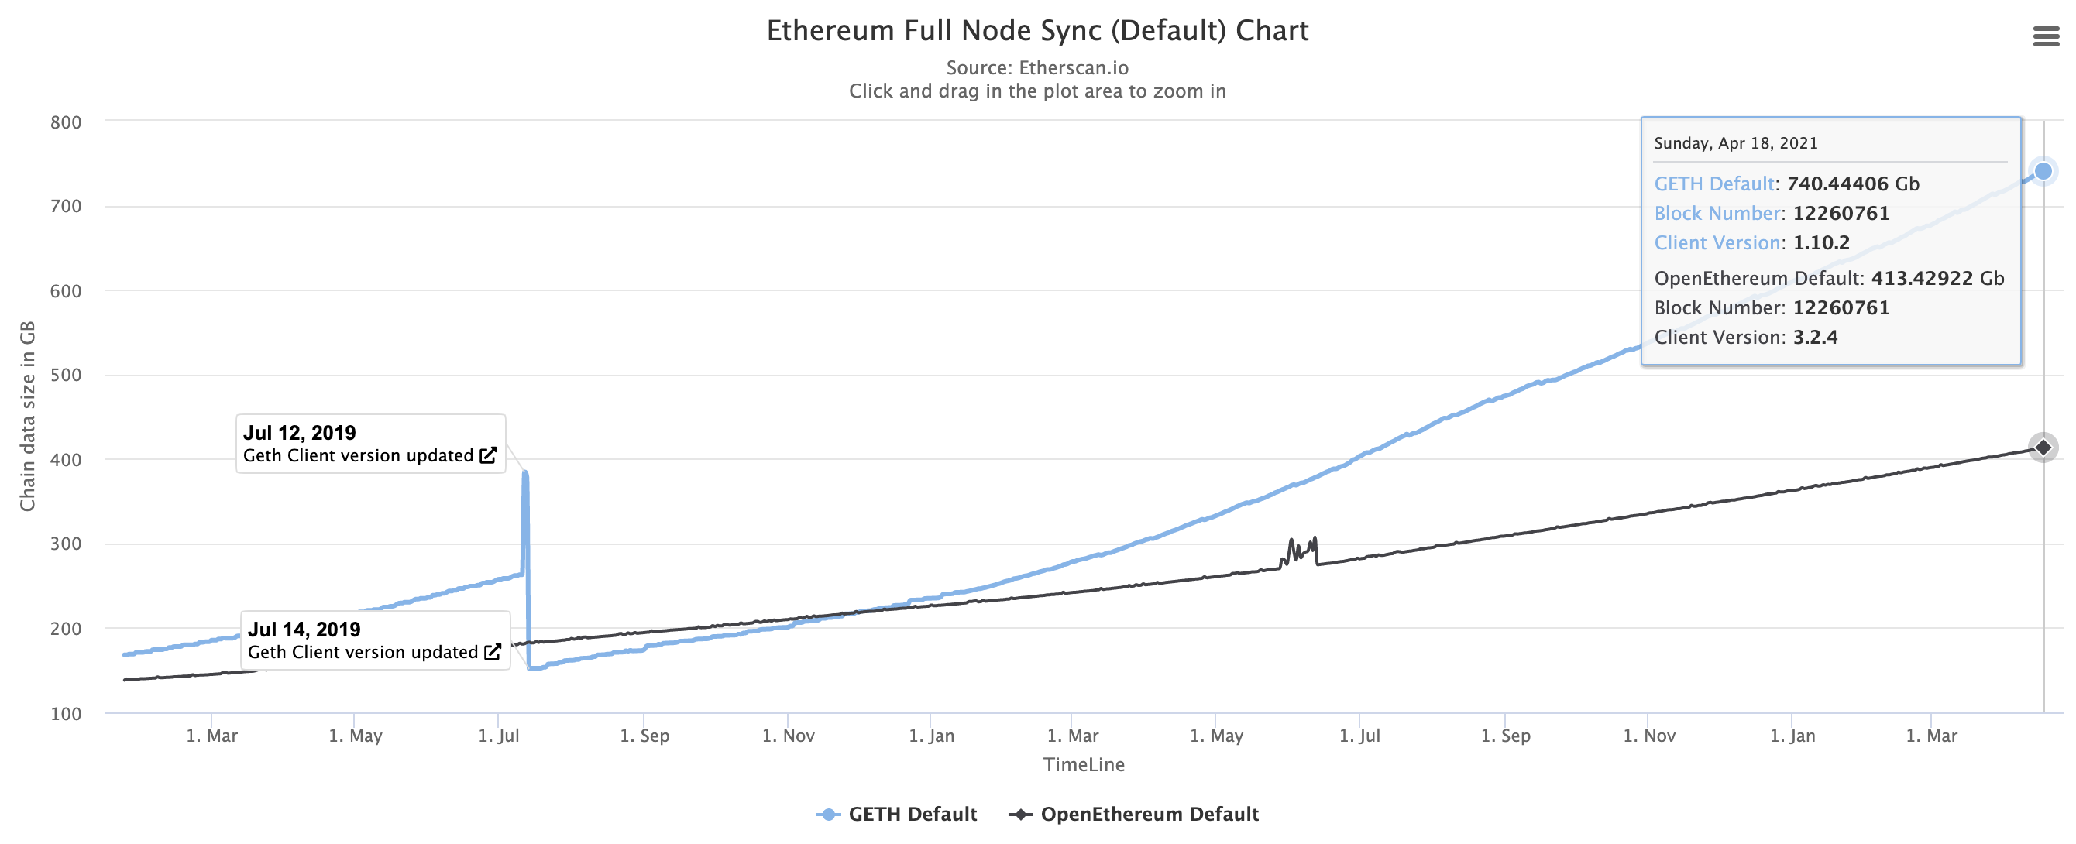
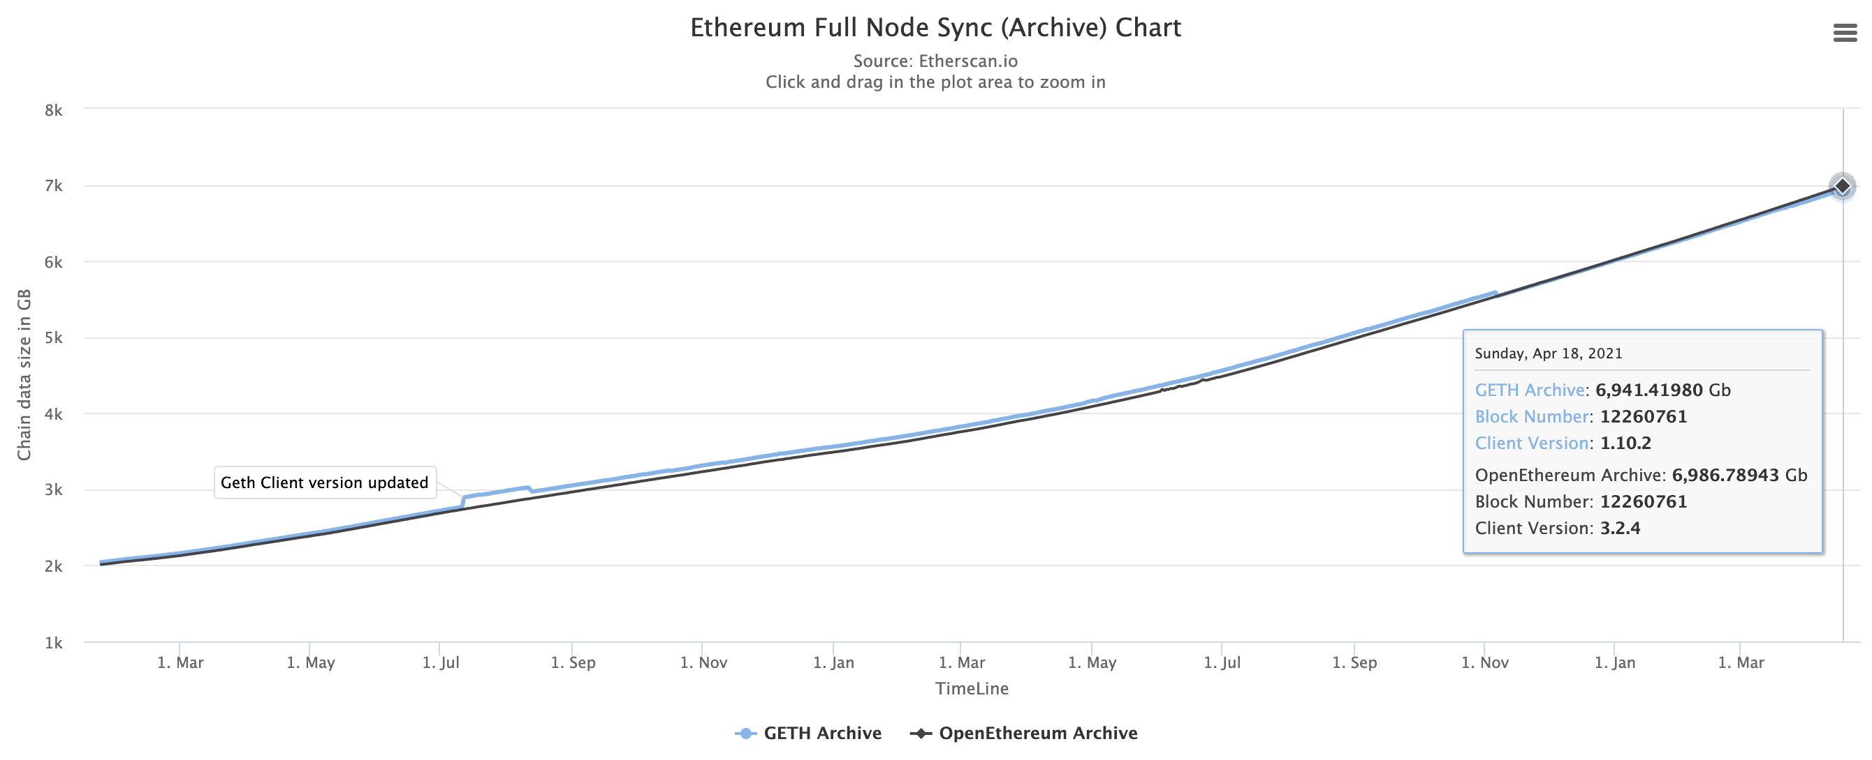
Introduction
Problem of account-based blockchain
One problem of account-based blockchain
Soaring number of accounts significantly increases storage size and bootstrapping time
E.g., Ethereum requires 6.9TB and few weeks (Archive Sync), or 740GB and few days (Fast Sync)
Most serious overhead is caused by state trie that saves account states
Notes:
However, the account-based model suffers from a huge storage size and long synchronization(bootstrapping) time.
For example, Ethereum requires 6.9TB and few weeks to catch a current block with archive sync, and it requires 740GB and few days with fast sync.
The most serious overhead of the storage size and bootstrapping time is caused by the state trie that saves account states.

Slide 4

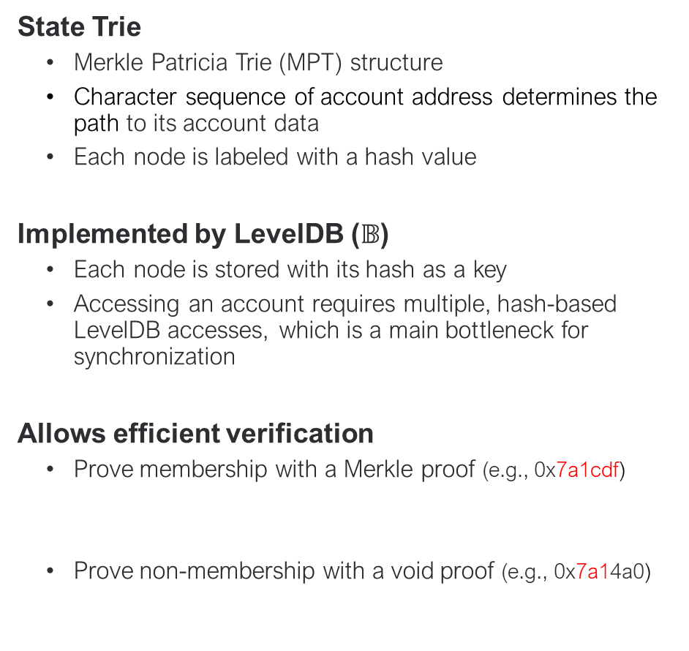

Review of Ethereum
State Trie
State Trie
Merkle Patricia Trie (MPT) structure
Character sequence of account address determines the path to its account data
Each node is labeled with a hash value
Implemented by LevelDB ($𝔹$)
Each node is stored with its hash as a key
Accessing an account requires multiple, hash-based LevelDB accesses, which is a main bottleneck for synchronization
Allows efficient verification
Prove membership with a Merkle proof (e.g., 0x7a1cdf)
Prove non-membership with a void proof (e.g., 0x7a14a0)
hash0
Branch node 0
0
1
2
3
4
5
6
7
8
9
a
b
c
d
e
f
7
hash1
Extension node 0
…
a1
a1
hash2
Branch node 1
0
1
2
3
4
5
6
7
8
9
a
b
c
d
e
f
c
hash3
…
null
Extension node 1
df
df
hash4
$$PM =[𝔹\left(hash0\right),𝔹\left(hash1\right),𝔹\left(hash2\right),𝔹\left(hash3\right),𝔹\left(hash4\right)]$$
$$hash0=hash\left(branch node 0\right)$$
$𝔹\left(hash0\right)=branch node 0$ ($𝔹:DB)$
address: 0x7a1cdf
account
$$PM =[𝔹\left(hash0\right),𝔹\left(hash1\right),𝔹\left(hash2\right)]$$
Notes:
So, before we talk about Ethanos, let’s review Ethereum to learn some background.
Ethereum stores each account at the state trie of which structure is Merkle Patricia Trie or MPT.
In MPT, the character sequence of an account address determines the path to its account data, and each node is labeled with a hash value.
This MPT is implemented by levelDB that each node is stored with its hash as a key.
Accessing an account requires multiple, hash-based LevelDB accesses, which is a main bottleneck of synchronization.
MPT also allows efficient verification.
First, it can prove membership with a Merkle proof. For example, we can verify that an account 0x7a1cdf exists in this MPT with a Merkle proof including branch node 0, extension node 0, branch node 1, extension node 1, and the account, which is represented as B(hash0), B(hash1), B(hash2), B(hash3), and B(hash4).
Second, it can also prove non-membership with a void proof. For example, we can verify that an account 0x7a14a0 is not in the MPT with a void proof, including branch node 0, extension node 0, and branch node 1, which is represented as B(hash0), B(hash1), and B(hash2) since there is no path to 4 in the branch node 1.

Slide 5
Review of Ethereum
Synchronization
What is synchronization? Reproducing current state to join Ethereum as a full node
Archive sync process
Download all blocks and reproduce all state tries from the genesis block
Fast sync process
Download all blocks, yet only the state trie of the pivot block (e.g., current block – 64)
Reproduce only the state tries from the pivot block to the current block
Even fast sync is slow because we need to traverse, transmit, and rebuild every node of a huge state trie, which suffer from intensive disk I/O
Genesis block
Current block
…
…
Genesis block
Pivot block
Current block
…
…
do not reproduce
Notes:
If a new node wants to join the network, it has to be a full node by downloading the blocks and reproducing the current block, called “synchronization.
”There are two synchronization processes in Ethereum.
Archive sync downloads all blocks and reproduces all state tries from the genesis block. Archive sync records all the histories of the blockchain, so it takes a huge space and a long time.
Fast sync downloads all blocks but also downloads the state trie of the pivot block that is 64 blocks before the current block and reproduces only the state tries from the pivot block.
Fast sync can reduce the cost of synchronization, but it is still slow because we need to traverse, transmit, and rebuild every node of a huge state trie, which suffers from intensive disk I/O.

Slide 6
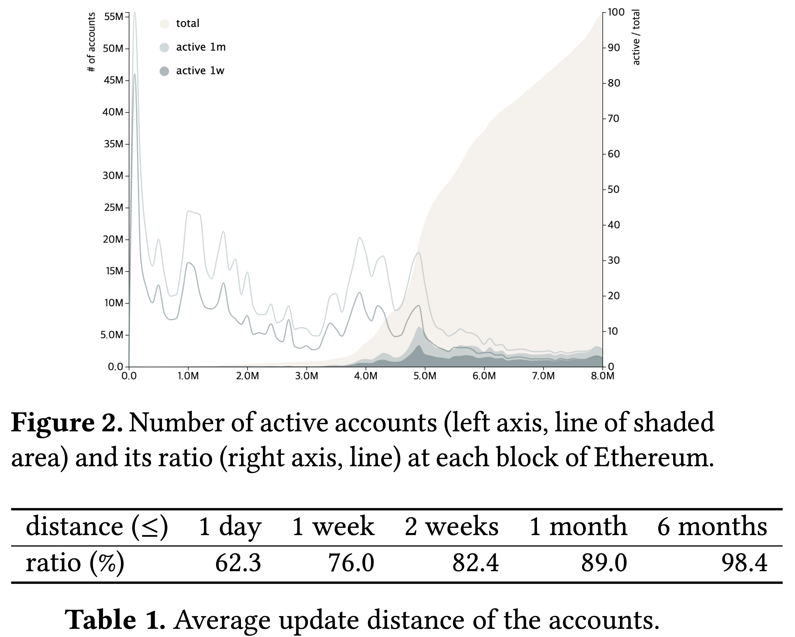
Observation of Ethereum Account Activities
Explore the tendency of active accounts
Most accounts are dormant
Only a fraction of accounts are active
~3% are active for 1 week, ~5% are active for 1 month
Once activated, likely to be accessed soon again
An account is updated in a week with a probability of 76%
An account is updated in a month with a probability of 89%
Notes:
To accelerate the synchronization, we first investigated Ethereum data, and observed that most accounts are dormant and only a fraction of accounts are active.
About 3% are active for 1 week, and about 5% are active for 1 month.
And we also found that once an account is activated, it likely to be accessed soon again.
An account is updated in a week with a probability of 76%, and in a month with a probability of 89%.

Slide 7






Ethanos
A novel state optimization technique for account-based blockchain
Sweep and Cache
Ethanos sweeps dormant accounts periodically by an epoch 𝜆 (e.g., ~40,000 blocks for 1 week period)
How? Simply creates empty trie every time a new epoch starts, after caching (checkpoint) previous epoch’s trie
Then, Ethanos fill it only with active accounts used by the transactions in the new epoch, sharply reducing trie
$$n^{th} epoch$$
$${n+1}^{th} epoch$$
$$n^{th} checkpoint$$
block num: $i (n∙λ$)
block num: $i+1 (n∙λ+1$)
block num: $i+2 (n∙λ+2$)
Tx root
State root
Tx root
State root
Tx root
State root
New empty trie
Notes:
So, we proposed Ethanos that sweeps dormant accounts periodically by an epoch lambda. For example, the lambda can be 40,000 blocks for 1 week period.
We call the last block of an epoch a checkpoint. Since it is extremely expensive to traverse a state trie to find and remove dormant accounts, Ethanos simply creates a new empty trie every time a new epoch starts, and fills it with the active accounts used by the transactions in the new epoch. Since the trie is initially empty, however, no account is available, so Ethanos caches the state trie as well.

Slide 8




Ethanos
A novel state optimization technique for account-based blockchain
Restore
If an account is not in current trie but in the cached trie, copy it to the current trie
If an account is not in neither of the tries,
If it is a sender, first restore itself with a restore transaction
If it is a receiver, create a “crumb” account as if we create a new account (merge later when it becomes a sender)
$$n^{th} epoch$$
$${n+1}^{th} epoch$$
$$n^{th} checkpoint$$
block num: $i (n∙λ$)
block num: $i+1 (n∙λ+1$)
block num: $i+2 (n∙λ+2$)
Tx root
State root
Tx root
State root
Tx root
State root
cached
copy & update
current
sweep
Notes:
If an account is not in the current trie but in the cached trie, copy it to the current tire.
However, if an account neither in the current trie nor in the cached trie, it should first be reactivated before it is a sender or a receiver of a transaction.
There are two cases.If it is a sender, first restore itself with a restore transaction
.If it is a receiver, create a “crumb” account as if we create a new account, then merge later when it becomes a sender.

Slide 9
Ethanos
Restoration of a dormant account
A receiver can be an active, new and crumb account
Accessible from the current/cached trie
1 ETH
active
sender
receiver
Not accessible from the current/cached trie
new / crumb
crumb: a dormant account that receives values
Notes:
In Ethereum, when someone sends some value to an arbitrary address that does not exist, a new account for that address is created in the state trie.
However, we cannot distinguish the created account is new or reactivated.
So we call the reactivated dormant account “crumb”, which can be a sender of another transaction if it has enough balance.

Slide 10
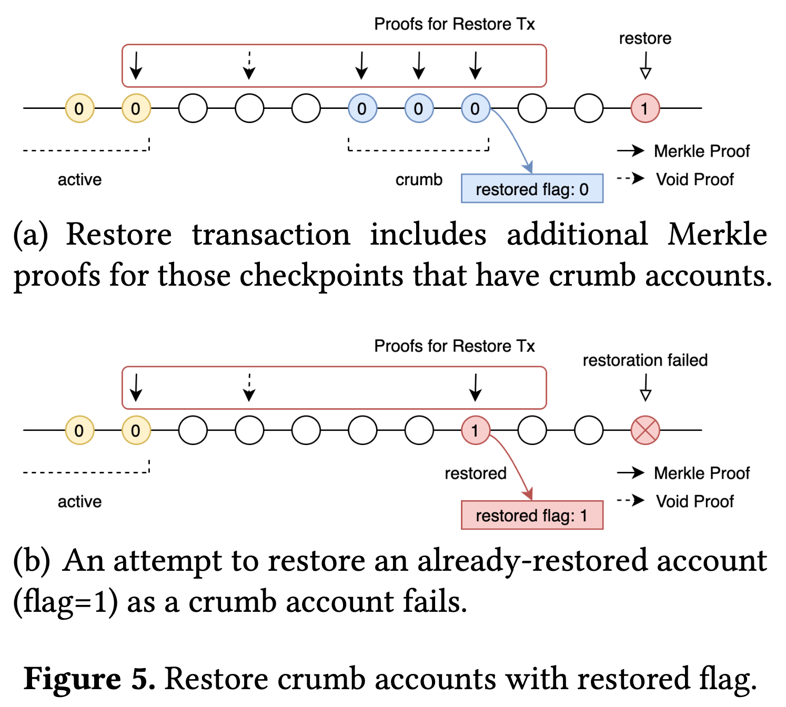
Ethanos
Restoration of a dormant account
Restore transaction
Restores the last active state of an account, possibly after merging its crumb states
How to avoid cheatings?
Restore transaction includes Merkle proofs and Void proofs, which will be verified by miners
Use restored flag to prevent an already restored account from behaving as if it is a crumb account
Notes:
If the crumb account does not have enough balance, it should transmit a restore transaction, which will merge the crumb accounts with the original account.
To avoid cheatings, a restore transaction includes merkle proofs and void proofs to prove that it is a dormant account and that its last state.
Since a merkle proof cannot distinguish between a crumb state and a restored state, we use the restored flag to prevent an already restored account from behaving as if it is a crumb account.

Slide 11
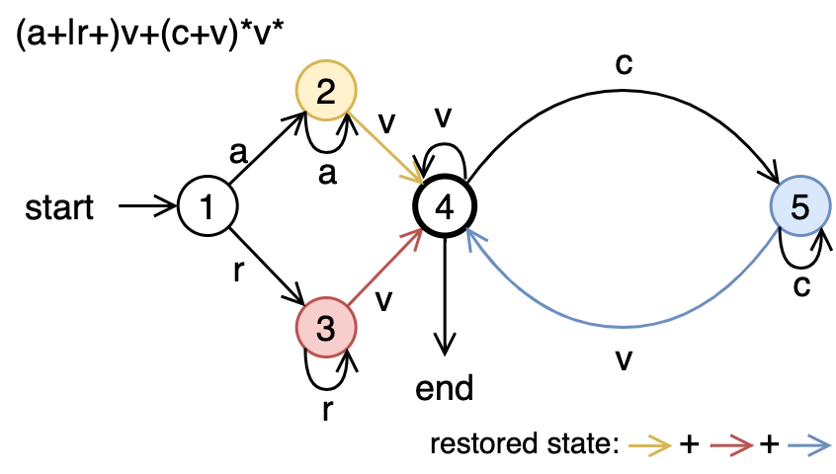

Ethanos
Restoration of a dormant account
Security Property
A valid state generated by a restore transaction can be expressed during a regular expression.
If a proof sequence of restore transaction does not follow the regEx, it is rejected.
Therefore, an attacker has no choice but to follow the regEx, but it only generates a correct state.
$${(a^{+}|r^{+})v^{+}(c^{+}v)}^{∗}v^{∗}$$
Notes:
A valid state generated by a restore transaction can be expressed during a regular expression like this.
If a proof sequence of restore transaction does not follow the regEx, it is rejected.
Therefore, an attacker has no choice but to follow the regEx, but it only generates a correct state.

Slide 12
Impact on Synchronization
Synchronization
For synchronization, Ethanos downloads state tries of both pivot and the latest checkpoint blocks
Each trie size is small (≤ ~220MB in our experiment for an epoch of 1 week)
If combined with other optimizations,
Compact Sync, similar to the fast sync but omits downloading old transactions before the pivot block
Omit less important block headers (e.g., NIPoPoW [2018])
➔ Bootstrapping with ≤ 1G within a few minutes would be plausible
Genesis block
Pivot block
Current block
…
…
do not download and reproduce
Notes:
For synchronization, Ethanos downloads state tries of both pivot and the latest checkpoint blocks, and each trie size is small.
If we omit to download old transactions before the pivot block, which we call compact sync, we can significantly reduce the storage size and the bootstrapping time.
Also, other techniques like NIPoPoW, omitting less important block headers, the bootstrapping cost can be much reduced.
And we think that bootstrapping with less than 1 GB within a few minutes would be plausible for ordinary people.

Slide 13
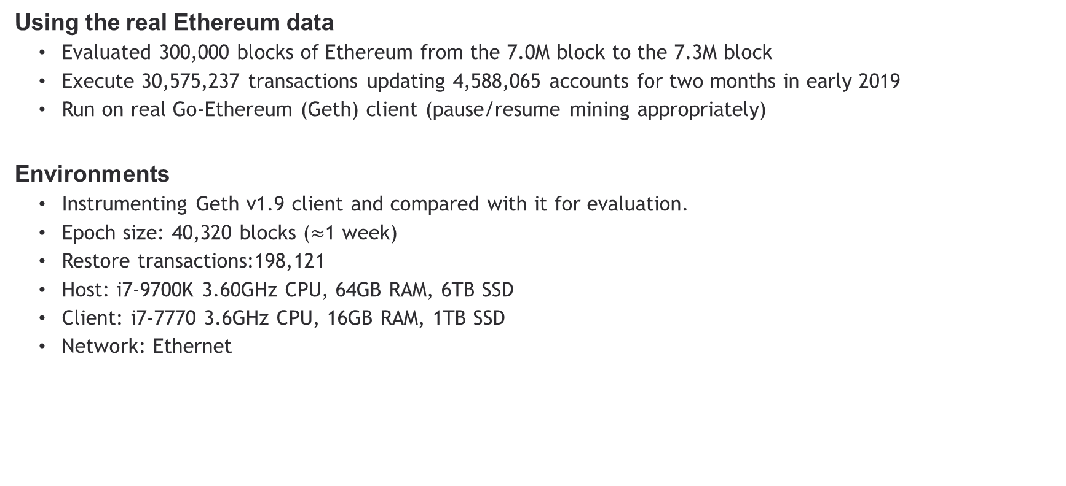
Evaluation
Environments
Using the real Ethereum data
Evaluated 300,000 blocks of Ethereum from the 7.0M block to the 7.3M block
Execute 30,575,237 transactions updating 4,588,065 accounts for two months in early 2019
Run on real Go-Ethereum (Geth) client (pause/resume mining appropriately)
Environments
Instrumenting Geth v1.9 client and compared with it for evaluation.
Epoch size: 40,320 blocks ($≈$1 week)
Restore transactions:198,121
Host: i7-9700K 3.60GHz CPU, 64GB RAM, 6TB SSD
Client: i7-7770 3.6GHz CPU, 16GB RAM, 1TB SSD
Network: Ethernet
Notes:
We used the real Ethereum data to evaluate Ethanos.
We evaluated 300 thousand blocks from 7 million block to the 7.3 million block where 30.6 million transactions update 4.6 million accounts for two months in early 2019.
And the experiment was run on the real geth client.
We instrumented geth client v1.9 to implement Ethanos and to compare it with the original geth.
And we set the epoch size 40,320 blocks which is about 1 week, and the number of restore transactions was 198 thousand 121.
The specification of the host is i7-9700k 3.6 GHz CPU, 64GB RAM, 6TB SSD, and the client is i7-7770 3.6GHz CPU, 16GB RAM, 1TB SSD.
And we connect the client who bootstraps and the host who provides the bootstrap data via Ethernet to reduce the impact of network fluctuation on synchronization time and the peer-drop failures

Slide 14
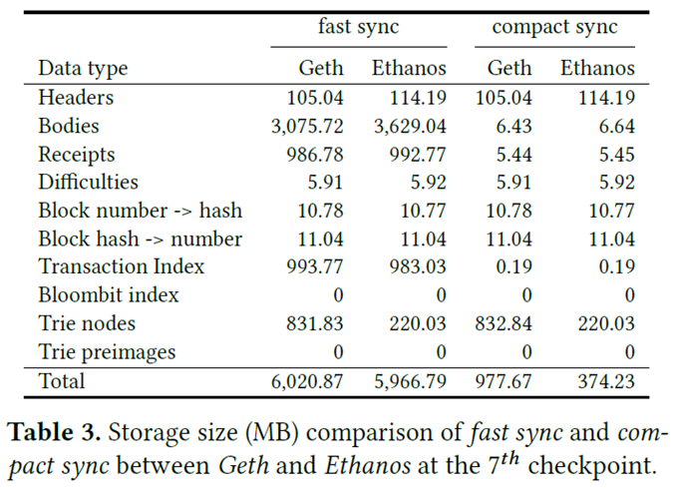
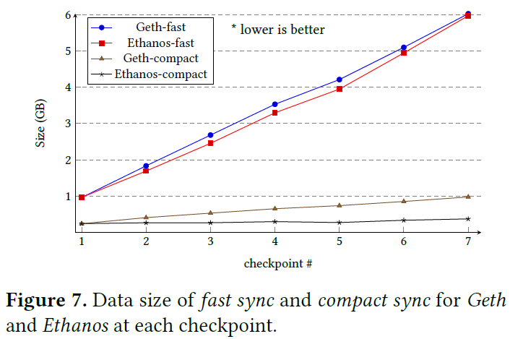

Evaluation
Storage Size
Compact Sync
Total size at the $7^{th}$checkpoint: 997 MB (Geth), 374 MB (Ethanos)
State trie size: 831 MB (Geth), 220 MB (Ethanos)
Total storage for compact sync will be under 594 MB (unlike Ethereum, the size remains almost constant)
594 MB would be reasonable for a client to bootstrap as a full node
Notes:
The experimental results show that the total storage sizes at the 7th checkpoint are 997MB for Geth and 374MB for Ethanos where the state trie size of Geth is 831MB and that of Ethanos is 220MB.
Therefore, the total storage size for compact sync will be under 594MB, which remains almost constant unlike Ethereum that continues to grow.
594MB would be reasonable for a client to bootstrap as a full node.

Slide 15
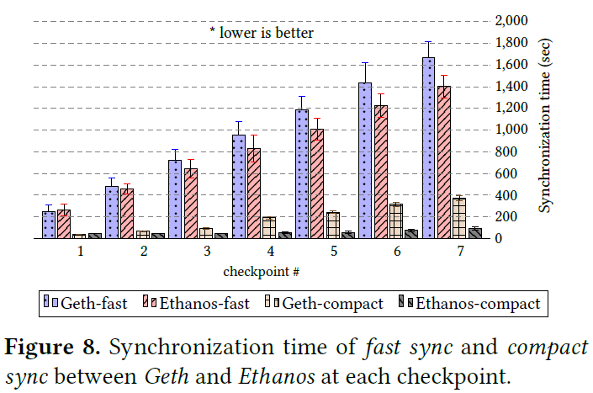
Evaluation
Synchronization time
Sync time comparison
Ethanos becomes tangibly faster than Geth in both fast sync and compact sync
Notes:
We also measured the synchronization time and found that Ethanos becomes tangibly faster than Geth in both fast sync and compact sync.
The bootstrapping time of Ethanos compact sync is almost constant over time.

Slide 16
Summary
Ethanos: Efficient Bootstrapping for Full Nodes on Account-based Blockchain
Ethanos
Periodically sweeps dormant accounts
Rebuilds the state trie only with active accounts
Restores dormant accounts when needed
Bootstrapping with ≤ 1GB and within a few minutes would be plausible for ordinary people
Allows occasional on-line users to be a full node whenever transmitting transactions
Notes:
In summary, Ethanos successfully reduced bootstrapping cost by periodically sweeps dormant accounts, rebuilds the state trie only with active accounts, and restores dormant accounts when needed.
Ethanos enables bootstrapping under 1 GB within a few minutes, which would be plausible for ordinary people.
And it will allow occasional on-line users to be a full node whenever transmitting transactions.

